Slide 1
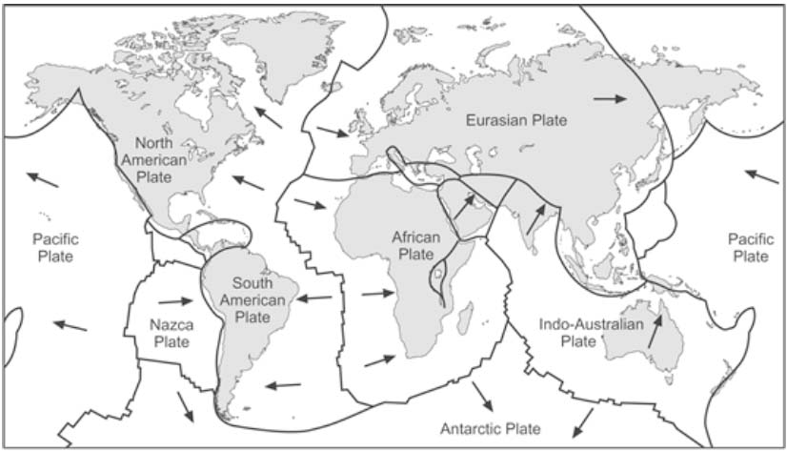
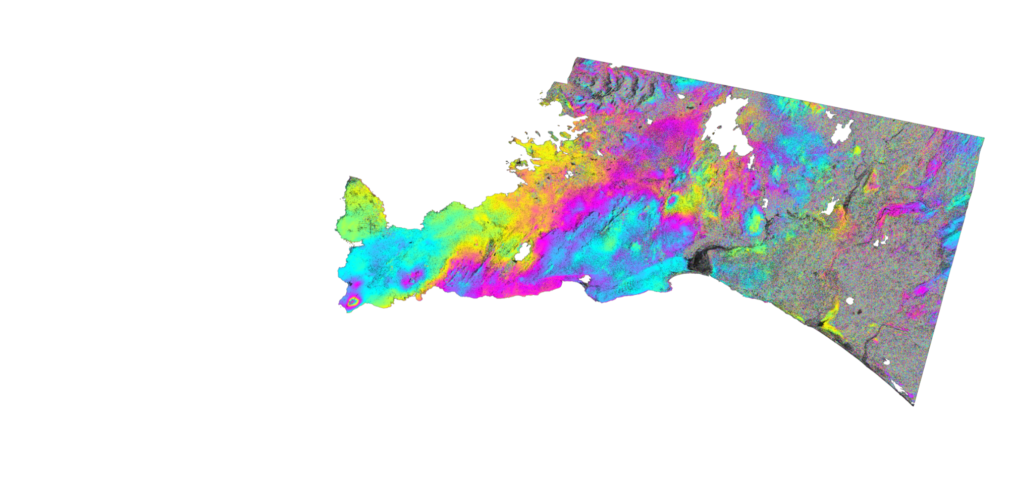


GROUND DEFORMATION DUE TO STEAM CAP PROCESSES AT REYKJANES, SW-ICELAND: EFFECTS OF GEOTHERMAL EXPLOITATION INFERRED FROM INTERFEROMETRIC ANALYSIS OF SENTINEL-1 IMAGES 2015-2017
Mylène Receveur ⁽¹⁾, Freysteinn Sigmundsson⁽¹⁾, Vincent Drouin^{(1,2)}, Michelle Parks ⁽³⁾
Nordic Volcanological Center, Institute of Earth Sciences, University of Iceland
National Land Survey of Iceland, Akranes, Iceland
Icelandic Meteorological Office
myr2@hi.is
Final Master project - Completed in June 2018
Notes:
Is subsidence due to production of the Reykjanes geothermal system still occurring in 2015-2017?
At which rate ?
What are the causes?

Slide 2
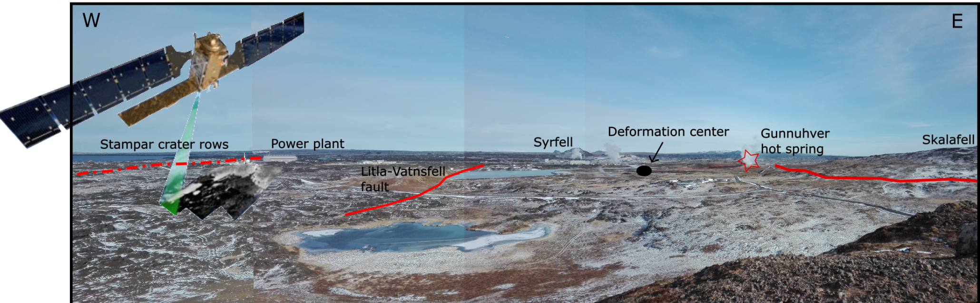
Highlights
Creation of average displacement maps from time series analysis of ground deformation using Sentinel-1 SAR data
Determination of the characteristics of the deformation source at depth using probabilistic inversion
Models of deformation processes within a steam zone using pressure and temperature data
Sentinel-1. Source : European Space Agency (ESA)
Source :Mylene Receveur
Notes:
Interferometric analysis of C-bands Sentinel-1A and S1B data from 2015 to 2017
Time series analysis : Determination of the deformation rate due to production of the Reykjanes geothermal system
Use of probabilistic inversion to determine the optimal parameters for the deformation source
Assessment of the possible causes of deformation

Slide 3
Introduction

Slide 4
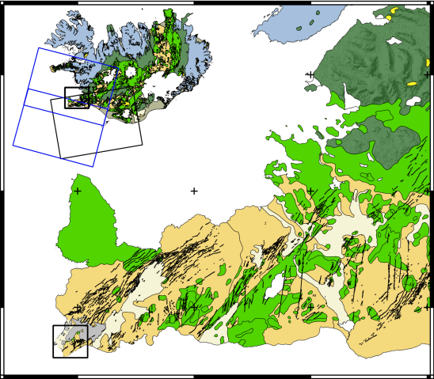
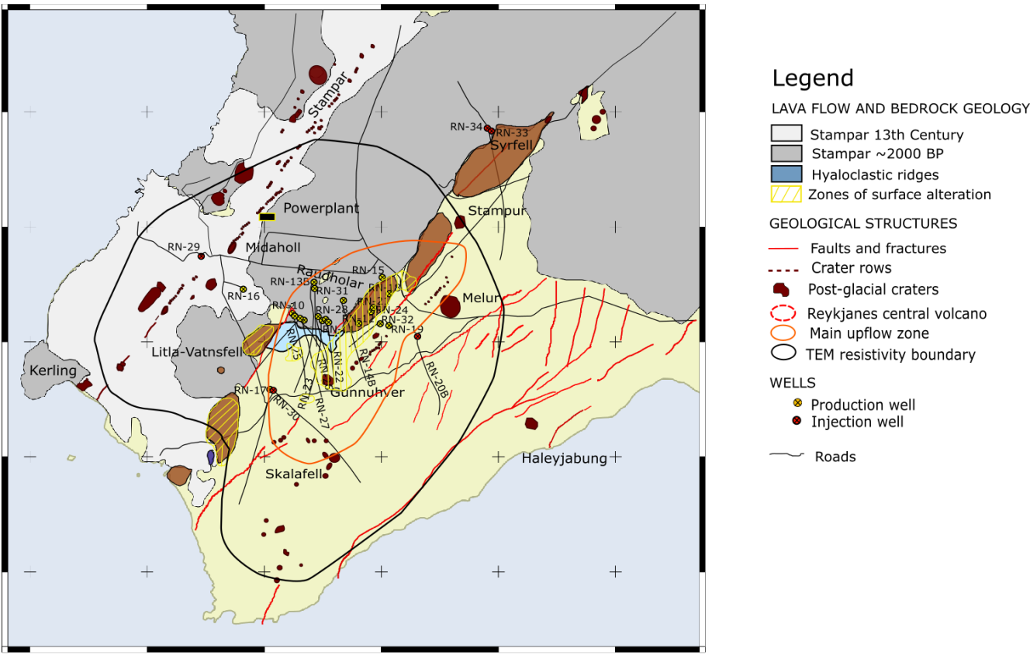
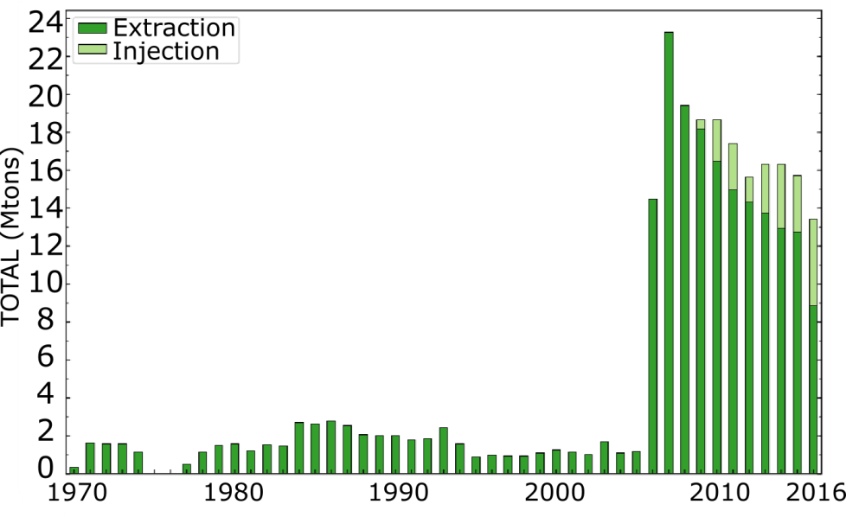
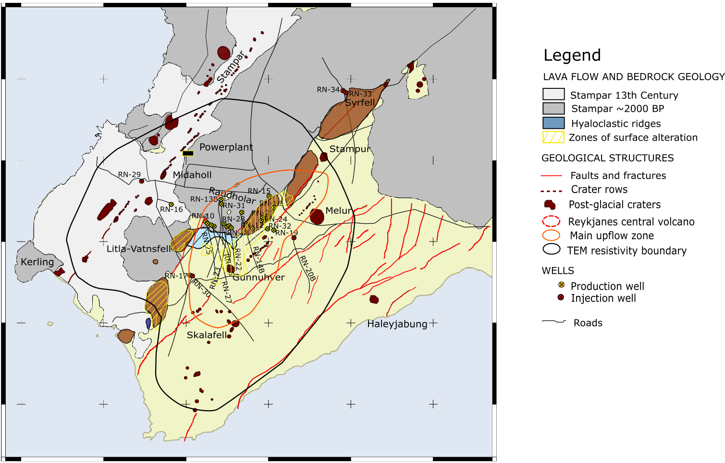
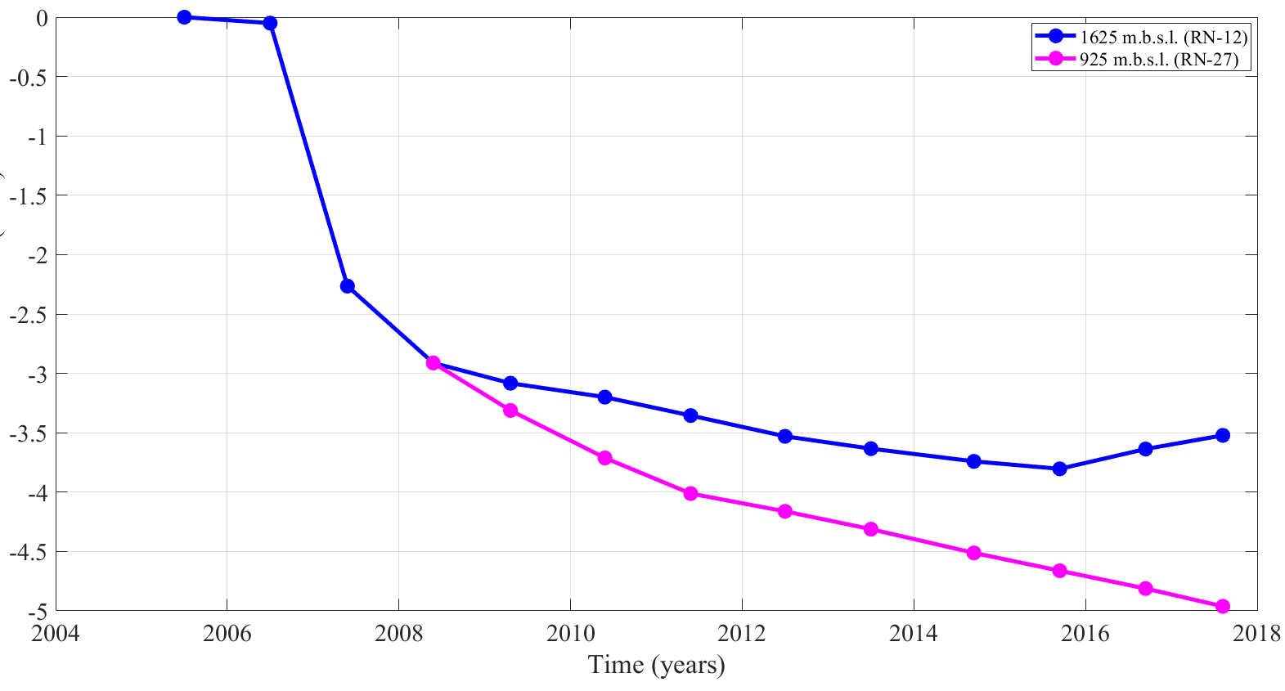
Introduction
Data
Modeling
Time series analysis
Interpretation
Conclusion
The Reykjanes geothermal system
Commissioning of the 100 Mwe power plant in 2006
17 production and 5 injection wells in 2015-2017
Injection since 2009
Average yearly next extraction of geothermal fluid 1970-2016 (Vatnaskil report, 2017)
Pressure (bar) 2006-2017
Source: HS-Orka; Thorvaldsson & Arnarsson, Vatnaskil report, 2017; Khodayar et al., 2016
Notes:
Figure 1. Location of the study area (black box) over Iceland (a) with the location of the Sentinel-1ascending and descending tracks, of (b) the Reykjanes Peninsula displaying the central volcanoes (red circles) and fissure swarms (black lines) and (c) the Reykjanes geothermal system with a well map (d)
Figure 2. a) Average yearly next extraction of geothermal fluid 1970-2016 (Vatnaskil report, 2017), b) pressure in wells RN-12 and RN-16

Slide 5
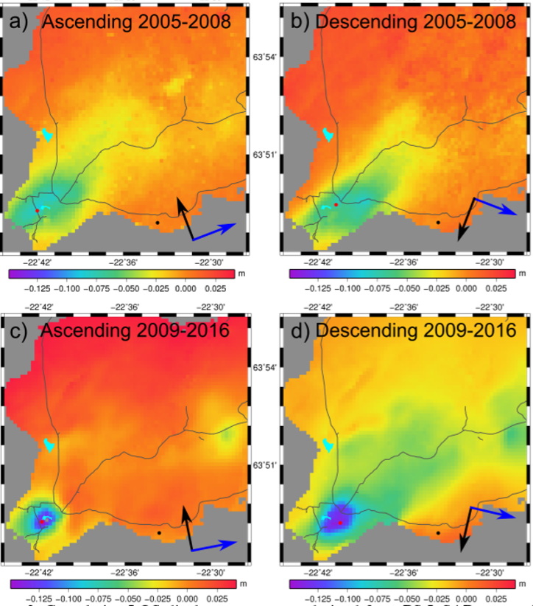
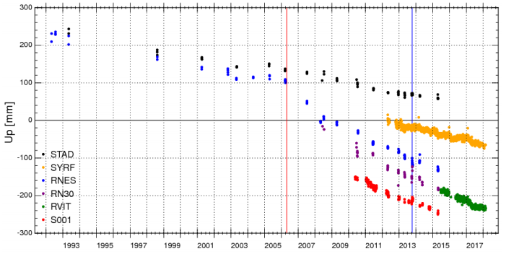
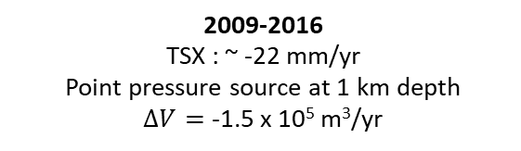
Introduction
Data
Modeling
Time series analysis
Interpretation
Conclusion
Previous deformation results
Parks et al. (2018)
2005-2008
ENVISAT: ~ -30 mm/yr
Ellipsoidal source at 2 km depth
$∆V=$ -7.3 x 10⁵ m³/yr
2005-2008
ENVISAT: ~ -30 mm/yr
Ellipsoidal source at 2 km depth
∆𝑉= -7.3 x 10⁵ m³/yr
2009-2016
TSX : ~ -22 mm/yr
Point pressure source at 1 km depth
$∆V=$ -1.5 x 10⁵ m³/yr
7 mm/yr
GPS Time series 1992-2018
5
5
Notes:
Cumulative displacement show subsidence or displacement away from the satellite between a reference point (zero LOS change) located at -22,5°W and 63,815°N and a point at the center of the deformation (Parks et al., in review).
Total 2005-2016
Inferred cumulative vertical displacement: -0,26 m
Contraction towards the center of deflation: 0.14 m.
Proposed scenarios (Parks et al., in review)
- Nonlinear relationship between pressure drop and deformation
- Thermal contraction associated with minor cooling at shallower level in the geothermal reservoir
- Reservoir compressibility change with time related to the formation of a steam cap

Slide 6
Data processing and analysis

Slide 7
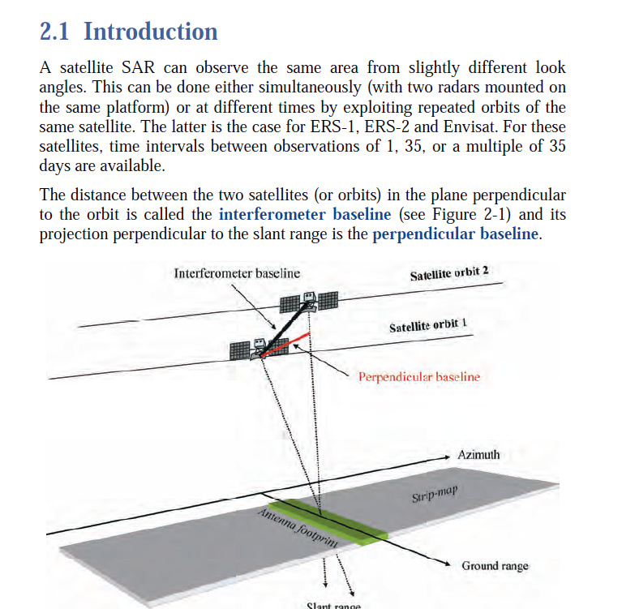

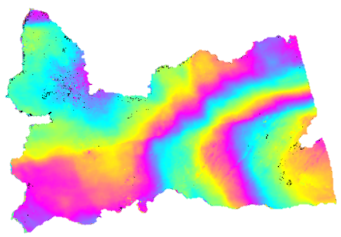
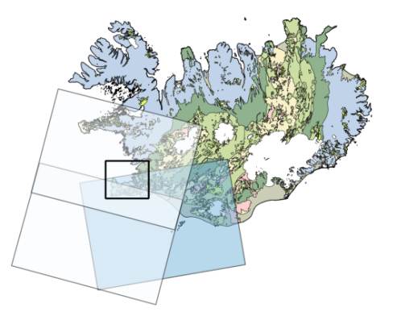
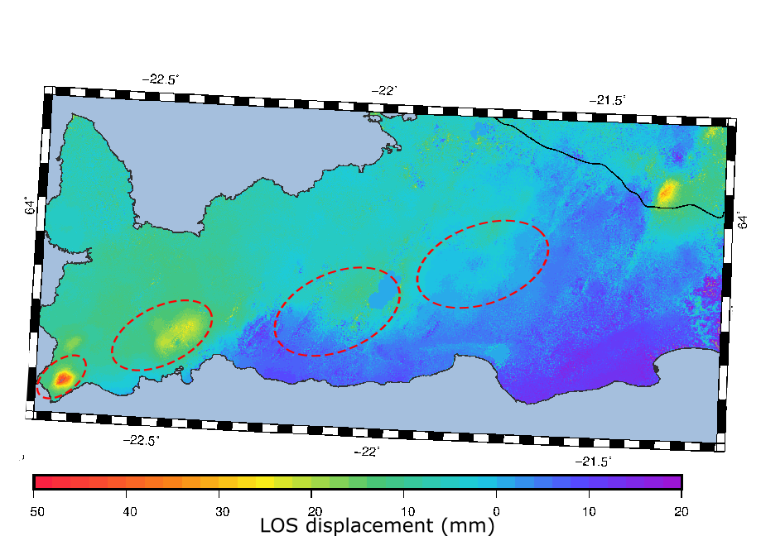
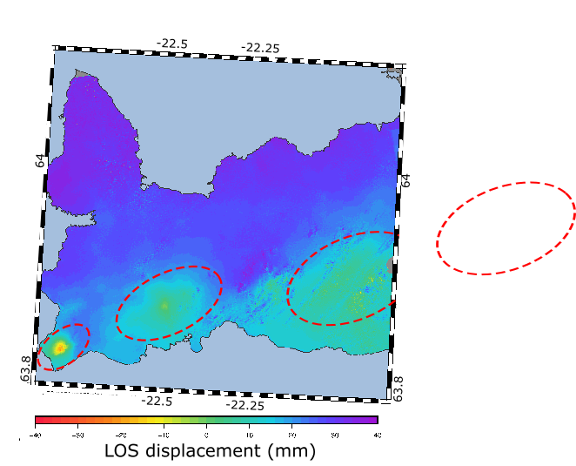
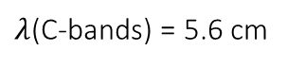
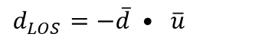
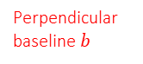
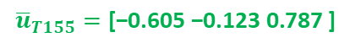
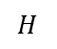

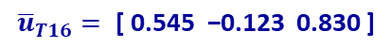
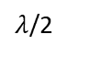

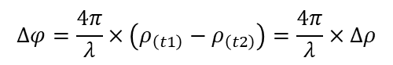
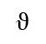

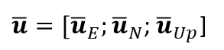
Introduction
Data
Modeling
Time series analysis
Interpretation
Conclusion
What is InSAR ?
$$∆φ=\frac{4π}{λ}×\left(ρ_{\left(t1\right)}−ρ_{\left(t2\right)}\right)=\frac{4π}{λ}×∆ρ$$
$$−π 0 +π$$
Perpendicular
baseline $b$
$$∆φ=φ_{deformation}+φ_{atmospheric}+φ_{orbit}+φ_{DEM error}+φ_{noise}$$
$$ϑ$$
Satellite
Line-Of-Sight (LOS)
$$H$$
$$d_{LOS}=−\overline{d} • \overline{u}$$
$$\overline{u}{=[\overline{u}}_{E};{\overline{u}}_{N}\text{;} {\overline{u}}_{Up}\text{]}$$
(Ferretti et al., 2007)
$λ$/2
$$Descending T155$$
$λ$(C-bands) = 5.6 cm
$$Ascending T16$$
Sentinel-1 mission
$${\overline{u}}_{T155}=\text{[}\text{−}\text{0.605 }\text{−}\text{0.123 0.787} \text{]}$$
$${\overline{u}}_{T16}= \text{[} \text{0.545} \text{−}\text{0.123 } \text{0.830} \text{]}$$
2 satellites : S1A and S1B
1 image every 6 days since 2016
2 tracks: Ascending and descending acquisitions
5 x 20 m resolution
7
Notes:
Radar interferometry
Ascending and descending acquisition
Detect large scale deformation
Phase change in LOS direction
5 x 20 m resolution

Slide 8
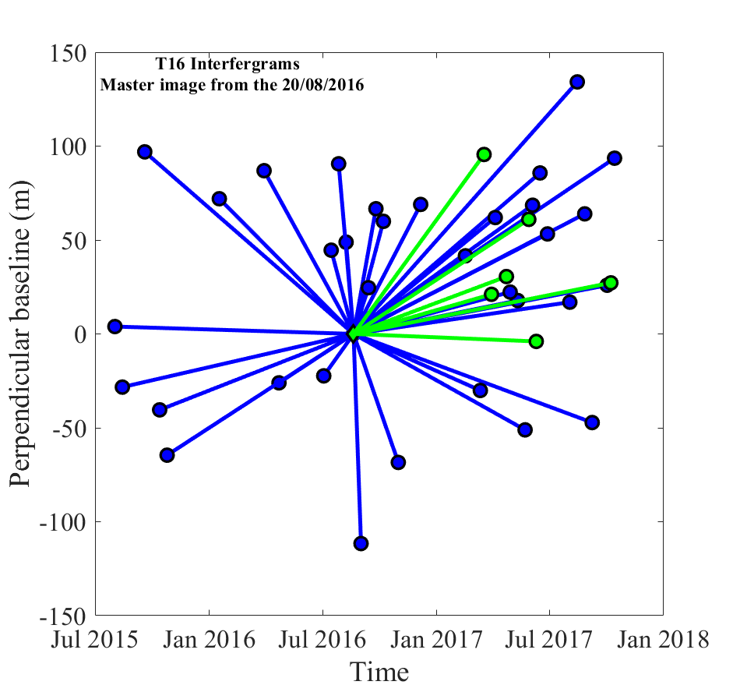
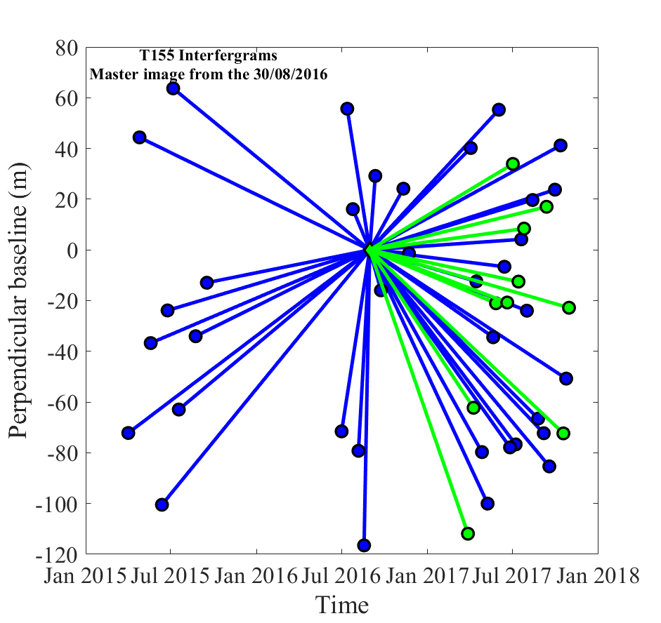
Introduction
Data
Modeling
Time series analysis
Interpretation
Conclusion
Perpendicular baseline
Time spanned: October 2014 – January 2018
Processing: ISCE software
ASCENDING TRACK
DESCENDING TRACK
S1A
S1B
104 SAR images
39 interferograms
804 days
107 SAR images
47 interferograms
942 days
8

Slide 9
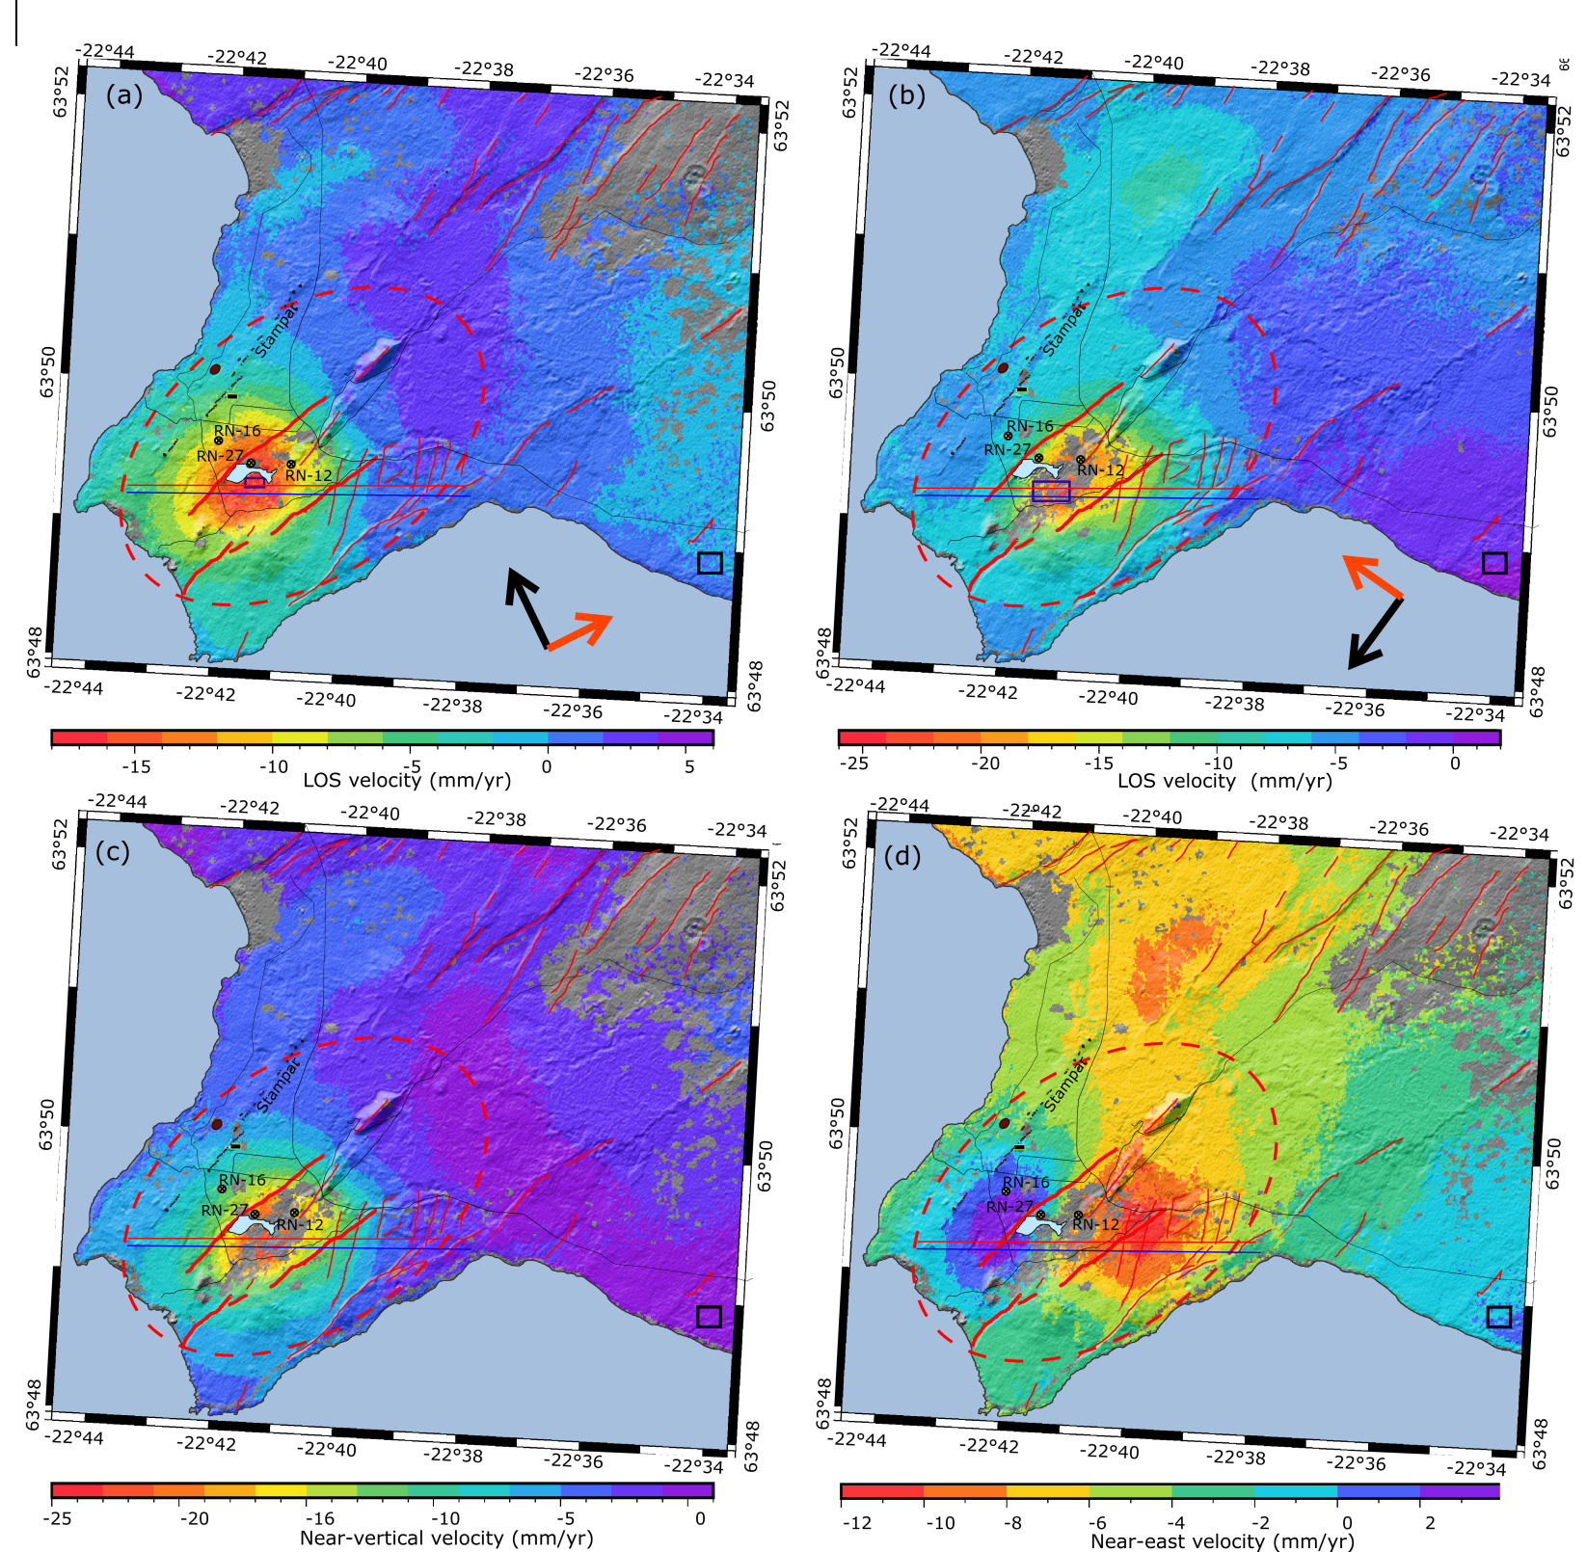
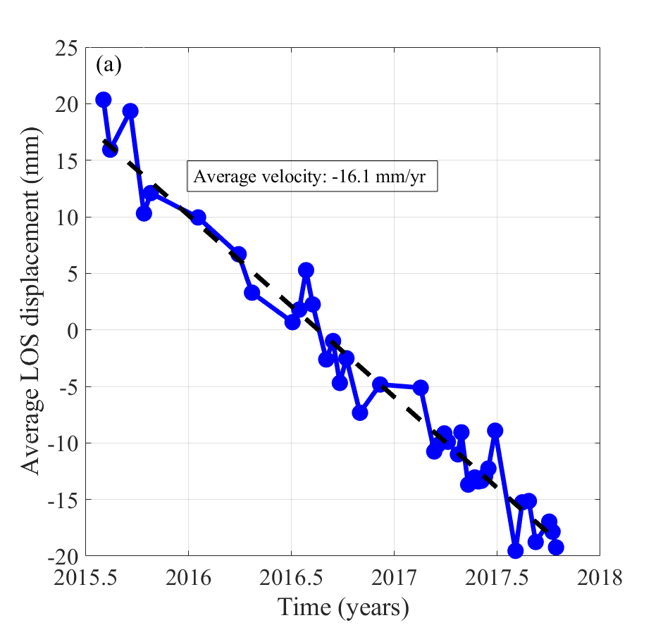
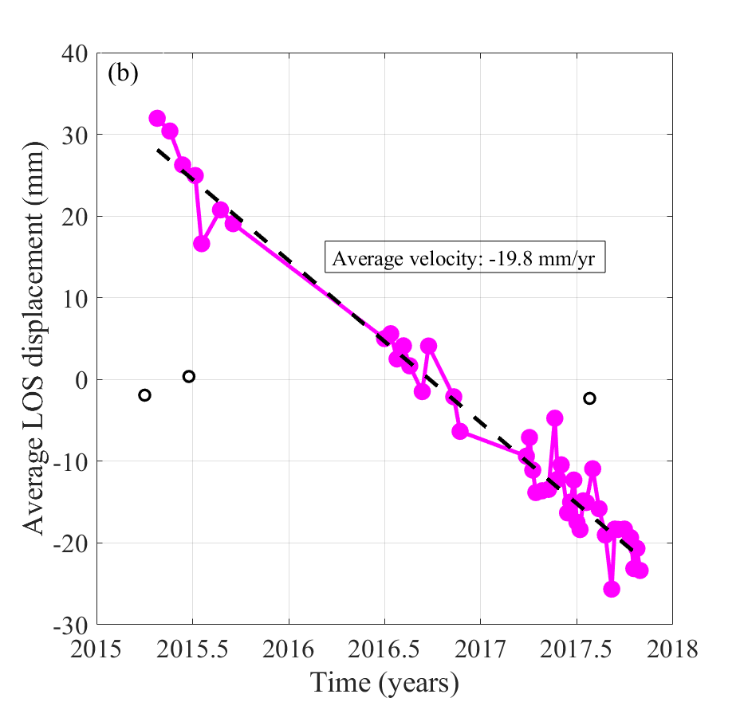
Introduction
Data
Modeling
Time series analysis
Interpretation
Conclusion
Velocity maps
Resolution: 40 x 40 m
Sub-circular subsidence bowl centered on the most productive area
Linear deformation: 16 mm/yr in the satellite LOS
Time series analysis for a set of point situated in the center of the most deforming area (black squares)
9
9
9
Notes:
Time series for the average displacement of a set of points situated in the most deforming area (center of well field)
Velocity maps for a) T16 and b) T155 , with location of the samples area for the time series analysis (black square), roads (black lines), fissures (red lines) and craters (red patches)
Times series analysis of the average displacement value of a set of points situated in the most deforming area, showing the displacement over time relatively to the master image (20-Aug-2016 for a) T16 and b)30-Aug-2016 for track T155

Slide 10
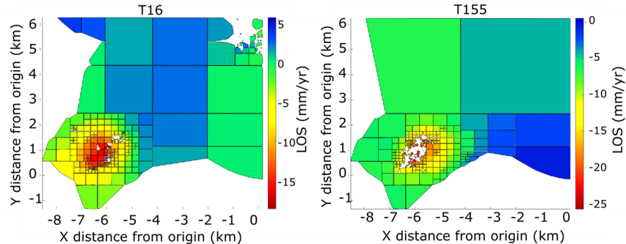
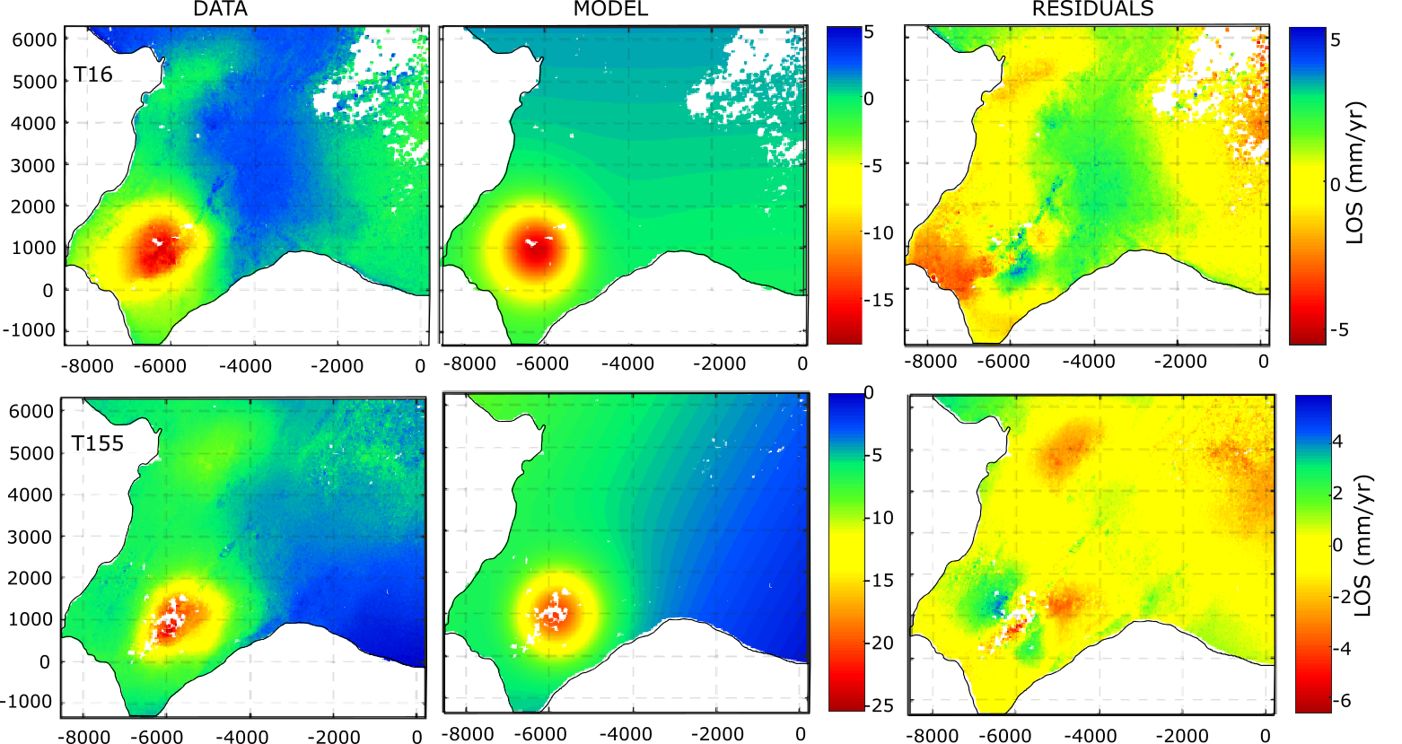
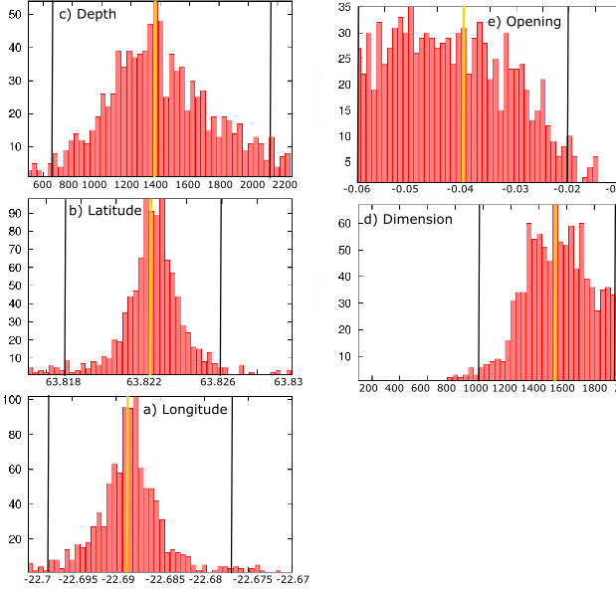
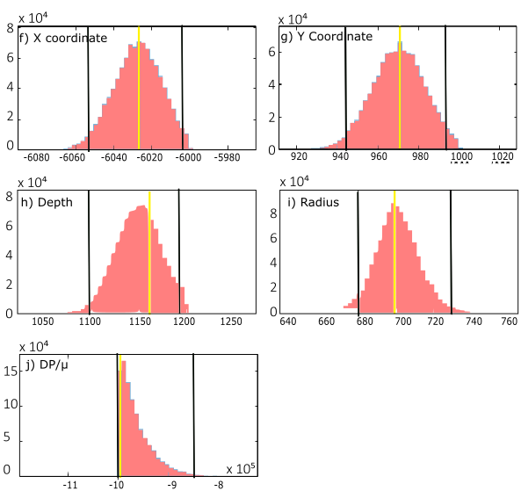
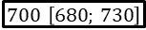
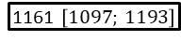
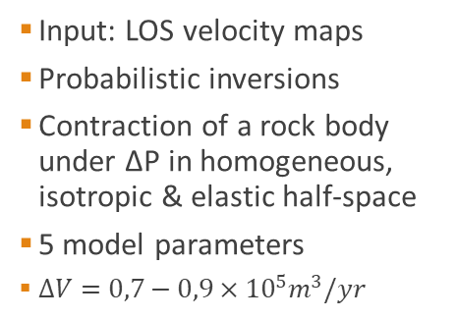
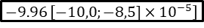
Introduction
Data
Modeling
Time series analysis
Interpretation
Conclusion
Analytical models
Quadtree sub-sampling
Input: LOS velocity maps
Probabilistic inversions
Contraction of a rock body under ΔP in homogeneous, isotropic & elastic half-space
5 model parameters
$∆V=0,7−0,9×{10}^{5}m^{3}/yr$
Okada sill with uniform closing
Grid sub-sampling : ~3500 observations
Bootstrap inversions (Drouin et al., 2017)
1357 m [666; 2156]
1531 [979; 1969]
-0,04 [ -0,06; -0,02]
Penny shaped crack
Quadtree sub-sampling: ~350 observations
Monte Carlo search (GBIS @ Bagnardi, 2017)
1161 $\left[1097; 1193\right]$
$−9.96$ $\left[−10,0;−8,5]×{10}^{−5}\right]$
$700$ $\left[680; 730\right]$
10
Notes:
a) Data, model and residuals and b) posterior probability density functions for each model parameters of the Okada layer (Okada, 1992)
Posterior probability density functions for the Penny shaped crack (Fialko and Simons, 2001)

Slide 11
Interpretation

Slide 12
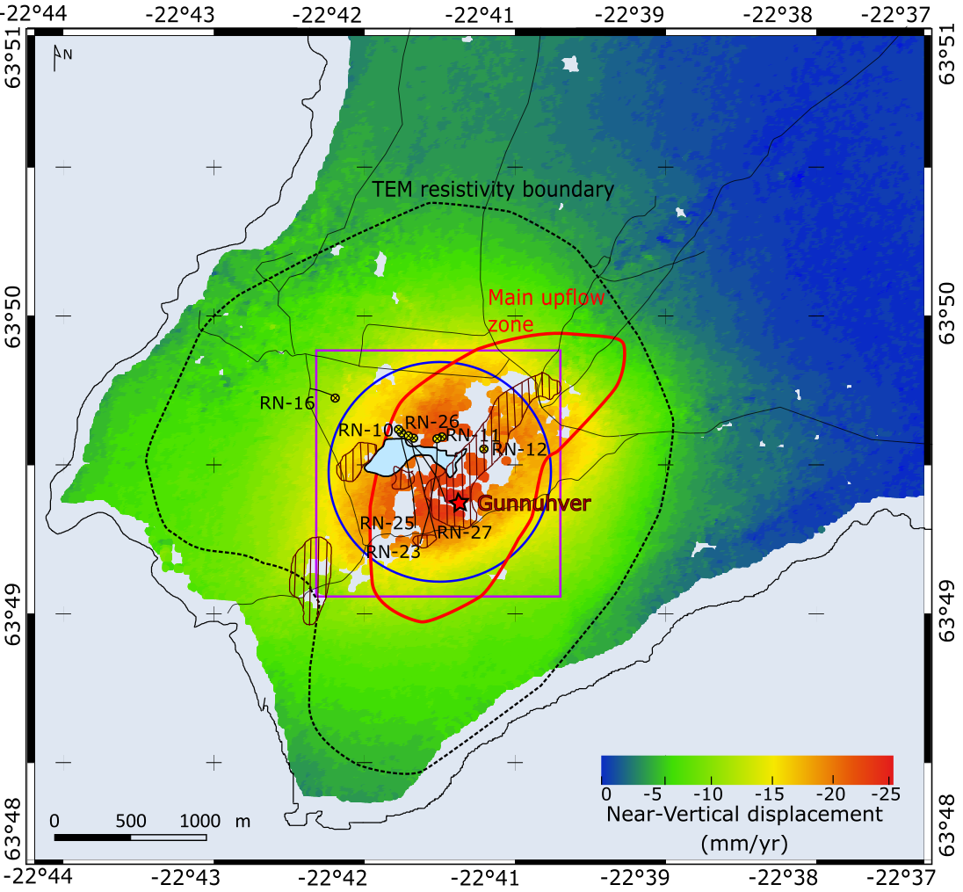
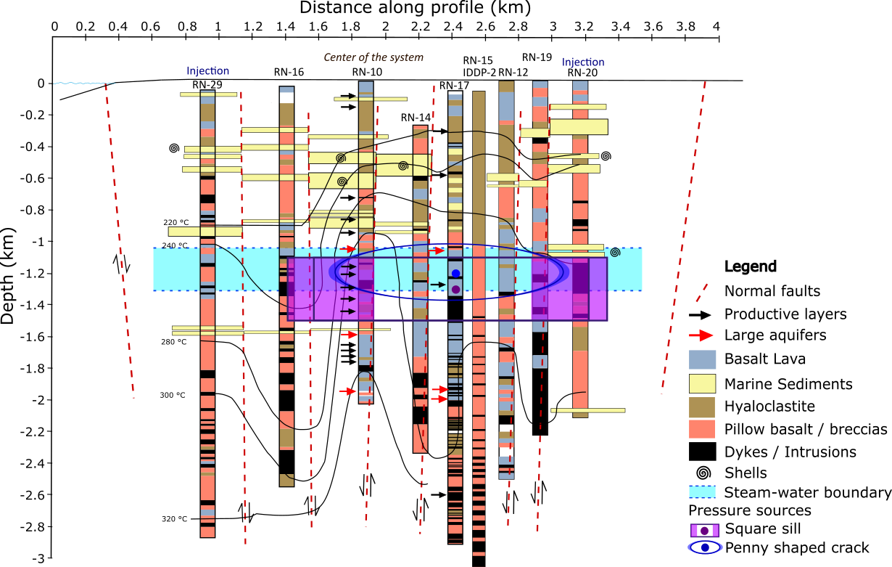
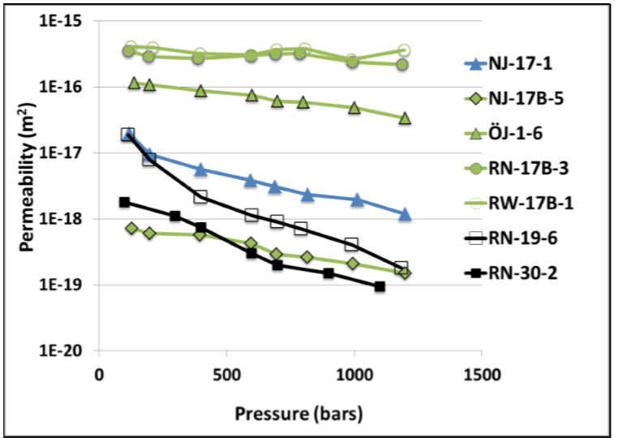
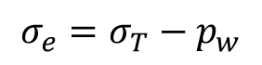
Introduction
Data
Modeling
Time series analysis
Interpretation
Conclusion
Relation between deformation sources and geological structure
Vertical displacement map
Reservoir area : 2 km²
~2 km thick
Steam-water
Boundary:
~400 m thick
Penny shaped
crack
Okada
Square sill
(modified from Friðleifsson et al., 2014; Khodayar et al., 2016)
$$σ_{e}=σ_{T}−p_{w}$$
Reinsch et al., 2016
12
12
Notes:
a) Vertical displacement map showing the location of the deformation sources in the Reykjanes geothermal system and the profile for the WNW-ESE geological profile displaying the well logs in the graben structure, the steam-water boundary, the isotherms and the modelled pressure sources

Slide 13
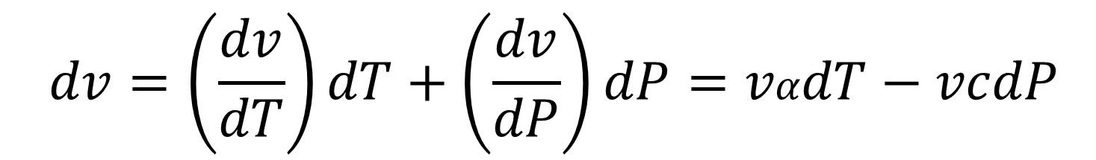
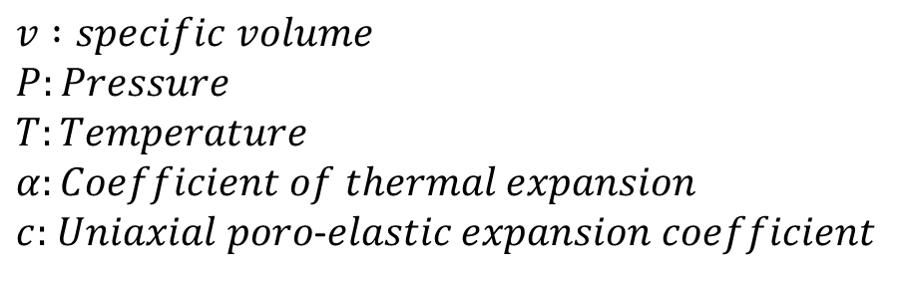
Introduction
Data
Modeling
Time series analysis
Interpretation
Conclusion
$$dv=\left(\frac{dv}{dT}\right)dT+\left(\frac{dv}{dP}\right)dP=vαdT−vcdP$$
$$v :specific volume$$
$$P:Pressure$$
$$T:Temperature$$
$$α:Coefficient of thermal expansion$$
$c:$ 𝑈𝑛𝑖𝑎𝑥𝑖𝑎𝑙 𝑝𝑜𝑟𝑜-𝑒𝑙𝑎𝑠𝑡𝑖𝑐 𝑒𝑥𝑝𝑎𝑛𝑠𝑖𝑜𝑛 𝑐𝑜𝑒𝑓𝑓𝑖𝑐𝑖𝑒𝑛𝑡
13

Slide 14
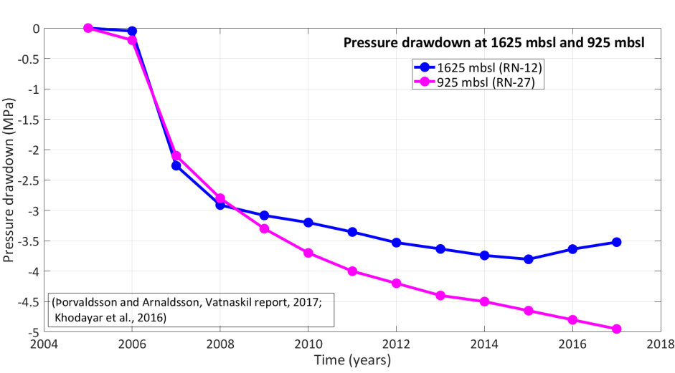
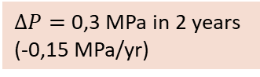
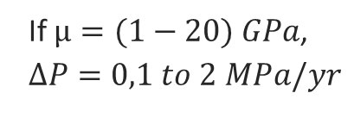

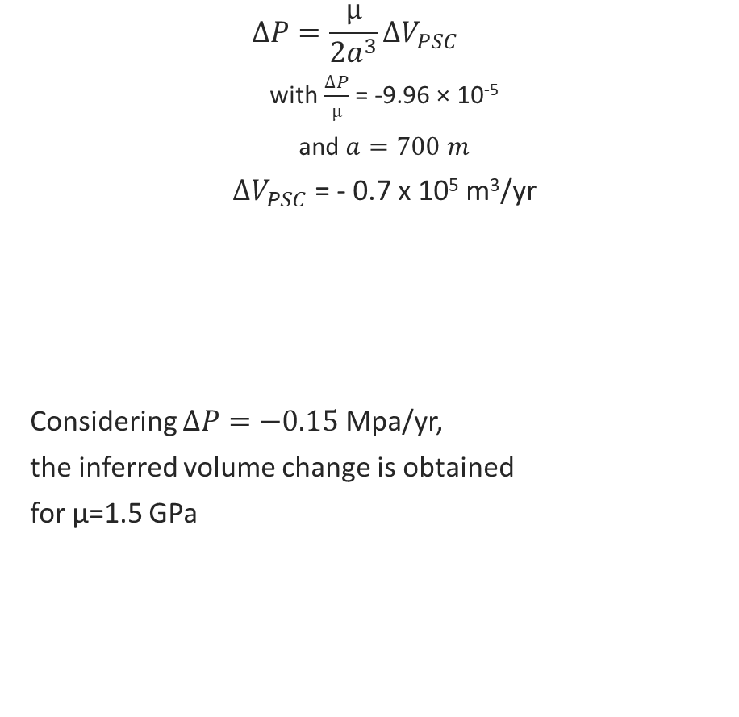
Introduction
Data
Modeling
Time series analysis
Interpretation
Conclusion
$$dv=\left(\frac{dv}{dT}\right)dT+\left(\frac{dv}{dP}\right)dP=vαdT−vcdP$$
In a Penny shaped crack:
$$∆P=\frac{µ}{2a^{3}}{∆V}_{PSC}$$
with $\frac{∆P}{µ}$ = -9.96 × 10⁻⁵
and $a=700 m$
${∆V}_{PSC}$ = - 0.7 x 10⁵ m³/yr
Considering $∆P=−0.15$Mpa/yr,
the inferred volume change is obtained
for µ=1.5 GPa
1) Pressure change
2) Cooling within a horizontal layer
3) Delayed rock compaction
If $µ=(1−20) GPa$,
$$∆P=0,1 to 2 MPa/yr$$
Source: Thorvaldsson & Arnarsson, Vatnaskil report, 2017; Khodayar et al., 2016)
$∆P=$ 0,3 MPa in 2 years
(-0,15 MPa/yr)
14

Slide 15
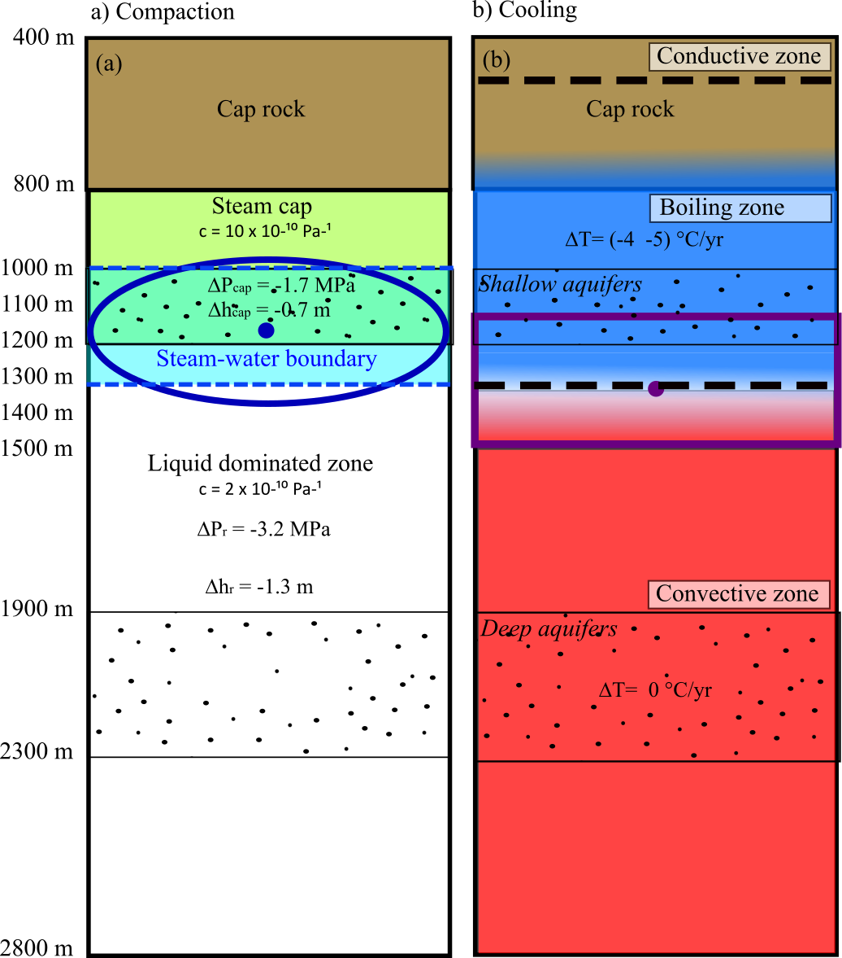





Introduction
Data
Modeling
Time series analysis
Interpretation
Conclusion
$$dv=\left(\frac{dv}{dT}\right)dT+\left(\frac{dv}{dP}\right)dP=vαdT−vcdP$$
In the Okada layer
$$∆h=γαh∆T=−0,04 m/yr$$
1) Pressure change
2) Cooling within a horizontal layer
3) Delayed rock compaction
I$f γα=(1−5)×{10}^{−5 }°C^{−1}$
with $∆T=−4 °C/yr$
$$h =200 to 1000 m$$
At 925 m b.s.l
${∆T}_{2009−2015}=$30°C
$$h=600 m$$
15

Slide 16












Introduction
Data
Modeling
Time series analysis
Interpretation
Conclusion
$$dv=\left(\frac{dv}{dT}\right)dT+\left(\frac{dv}{dP}\right)dP=vαdT−vcdP$$
Non-linear relationship between pressure and volume change
Change in isothermal compressibility (steam zone)
$$∆V=c∆PV$$
1) Pressure change
2) Cooling within a horizontal layer
3) Delayed rock compaction
$∆P=$ - 2.9 MPa
[2005-2008]
$$∆V=−2.3×{10}^{6} m^{3}$$
$c=$ $2.0{×10}^{−10}Pa^{−1}$
For $V_{reservoir}=3,8 km^{3}$
$∆P=$- 0.15 MPa
[2016-2017]
$∆V_{reservoir}$+ $∆V_{steam cap}$
$$=(−2,6×{10}^{6})+\left(−1,3×{10}^{6}\right)$$
$$=−3,9×{10}^{6}m^{3}$$
$$=∆V_{tot(2005−2017)}$$
$$∆V=−0.9×{10}^{5}m^{3}$$
$$c=1×{10}^{−9}Pa^{−1}$$
For $V_{steam cap}=0,7 km^{3}$
16
Notes:
Comparison of temporal deformation rate and models to net extraction of geothermal fluids from the Reykjanes geothermal area and to the net pressure/temperature changes observed at 1600 mbgl in monitoring wells, RN-12 (production well always measured 2-3 days after stopping the production) & RN-16 (observation well), situated in the center and at the periphery of the deformation bowl, respectively.
Annual extraction in 2016: 13,500 million tons per year.
Summary: Effect of pressure drop generally larger at the beginning of utilization, and once pressure conditions reach a steady state , then the effects of temperature become dominant. This was suggested in Krafla (Drouin et al., 2017) where a temperature of 0.5ºC/year has been inferred in a monitoring well. In the Hengill geothermal area, pressure drop is inferred to be the main reason for continuous deflation at Hellisheidi and Nesjavellir geothermal power plants (Juncu et al., 2017), where relatively steady pressure decrease rates of 0.25 MPa/yr and 0.1 MPa/yr was measured, respectively, in the studied 2007-2015 period.
Conclusion: At Reykjanes the comparison of deformation and observed changes in the reservoir conditions appear not as straight forward. Nevertheless, they reveal the importance of ground deformation due to utilization of a geothermal reservoir, as conditions may be changing although pressure and temperature recordings from individual monitoring wells may be showing relatively steady conditions.
If $h_{r}=600 m$
$$∆T=−7 to−2°C/yr$$

Slide 17
Conclusion
Steam cap processes explain continued subsidence at Reykjanes in 2015-2017
Geothermal fields in New Zealand (i.e. Samsonov et al., 2011; Brockbank, 2011; Bromley et al., 2015)
Analysis using ERS and Envisat data
Subsidence due to creep deformation in highly altered/compressible layers under slow diffusion of pressure decline
Sentinel-1 InSAR successfully captures deformation using only two years of data. Ideal location at Reykjanes (flat & vegetation free area)
Can be used to guide re-injection to maintain reservoir pressure and preserve steam zone
Future: Numerical modeling of deformation processes with more constraints on coefficient of thermal expansion and compressibility
Reinjection, decrease in production rate
Decreased boiling & steam recharge
Pressure & Temperature decline in steam zone
Steam condensation / re-saturation
17
Notes:
Combination of pressure, temperature decline and compressibility change in a steam cap can explain subsidence in 2015-2017
Compaction and thermal contraction at about 1 km depth
Deformation processes might be related to:
Possible heat mining induced by cold water recharge / reinjection in the upper part of the reservoir
Steam condensation and decrease in boiling / steam recharge
Sentinel-1 InSAR successfully captures deformation at Reykjanes using only two years of data. Ideal location at Reykjanes (flat and vegetation-free area)
Total vertical displacement of -0.28 m & contraction of 0.21 m in 2017
Deformation related to the two-phase nature of the geothernal system

Slide 18

Thanks f r your attention !
Questions ?

Slide 19
References
Allis, R., Bromley, C.J., Currie, S.: Update on subsidence at the Wairakei-Tauhara geothermal system, New Zealand, Geothermics, 38(1): (2009), 169-180.
Brockbank, K.; Bromley, C.J.; Glynn-Morris, T.: Overview of the Wairakei-Tauhara subsidence investigation program, Proceedings, 36th Workshop on Geothermal Reservoir Engineering, Stanford University, Stanford, CA (2011), p 68-74.
Bromley, C., Currie, S., Jolly, S., Mannington, W., 2015. Subsidence: an Update on New Zealand Geothermal Deformation Observations and Mechanisms. In: Proceedings World Geothermal Congress 2015, Melbourne, Australia. pp 9
Hole, J.K., Bromley, C.J., Stevens, N., Wadge, G.: Subsidence in the geothermal fields of the Taupo Volcanic Zone, New Zealand from 1996 to 2005 measured by InSAR, Journal of Volcanology and Geothermal Research, 166(3/4): (2007), 125-146.
Samsonov, S., Beavan, J., Gonzalez, P.J., Tiampo, K., Fernandez, J.: Ground deformation in the Taupo Volcanic Zone, New Zealand, observed by ALOS PALSAR interferometry, Geophysics Journal International, 187, (2011), 147 – 160.
Clifton, A., 2003. Fracture populations on the Reykjanes Peninsula, Iceland: Comparison with experimental clay models of oblique rifting. In: Journal of geophysical research, Vol, 108, NO. B2, 2074, doi:10.1029/2001JB000635
Drouin, V., Sigmundsson, F., Verhagen, S., Ofeigsson, B.G., Spaans, K., Hreinsdottir, S., 2017. Deformation at Krafla and Bjarnaflag geothermal areas, Northern Vocanic Zone of Iceland, 1993-2003. In: Journal of Volcanology and Geothermal Research 344. 92-105.
Ferretti, A., Monti-Guarnieri, A., Prati, C., Rocca, F., 2007. InSAR Principles: Guidelines for SAR Interferometry Processing and Interpretation. European Space Agency. TM-19. ISBN: 92-9092-233-8 ISSN
Fialko,Y., Khazan,Y., Simons,M., 2001. Deformation due to a pressurized horizontal circular crack in an elastic half-space, with applications to volcano geodesy, Geophysical Journal International, 146, 181–190.
Friðleifsson, G.Ó., Sigurdsson, Ó., Thorbjörnsson, D., Karlsdottir, R., Gilason, Th., 2014. Preparation for drilling well IDDP-2 at Reykjanes. In: Geothermics 49. P119-126
Im, K., Elsworth, D., Guglielmi, Y., Mattioli, G.S., 2017. Geodetic imaging of thermal deformation in geothermal reservoirs – production, depletion and fault reactivation. In: Journal of Volcanology and Geothermal Research (unpublished). 13p
Þorvaldsson, L., Arnaldsson, A., 2017. Svartsengi-Reykjanes. Vinnslueftirlit fyrir árið 2016. Vatnaskil report for HS Orka. 54p
Mogi, K. 1958. Relations between the eruptions of various volcanoes and the deformations of the ground surfaces around them. In: Bulletin of the Earthquake Research Institute, Tokyo, 36, 99-134
Khodayar, M., Nielson, S., Hickson, C., Gudnason, E.A., Hardarson, B.S., Gudmundsottir, V., Halldorsdottir, S., Oskarsson, F., Weisenberger, T.B., Bjornsson, S., 2016. The 2016 Conceptual Model of Reykjanes Geothermal System, SW Iceland. ISOR Report. Project No: 15-0230. 110p
Okada, Y. 1985. Surface deformation due to shear and tensile faults in a halfspace, Bull. Seismol. Soc. Am., 75, 1135–1154.
Parks, M., Sigmundsson, F., Sigurdsson, O., Hopper, A., Hreinsdóttir, S., Ófeigsson, B., Ófeigsson, K., 2018i,Deformation due to geothermal exploitation at Reykjanes, Iceland, J. Volcanol. Geotherm. Res., pp 12. (Received paper).
Reinsch, T., Liotta, D., Hersir, G.P., 2016. Physical properties of rock at reservoir conditions. In: IMAGE Public Report nr D3-03. Version 2016.11.04. 70p
Wortham, CB., 2014. Vector deformation time-series from spaceborne motion compensation insar processors. In: A dissertation submitted to the department of electrical engineering. Standford University,
19

Slide 20





Introduction
Data
Modeling
Time series analysis
Interpretation
Conclusion
 | ${[\overline{u}}_{E};{\overline{u}}_{N}$; ${\overline{u}}_{Up}$]
${\overline{u}}_{T16}$ +${ \overline{u}}_{T155}$ | [0.060, 0.246, 1.617]
${\overline{u}}_{T16}$ - ${\overline{u}}_{T155}$ | [-1.149, -0.001, 0.043]
Near-vertical and near-east displacements
Near-vertical (mm/yr)
Near-east (mm/yr)
$$n_{V}\sim \frac{d_{ASC}+d_{DES}}{1.617}$$
$$=−\frac{\left[{\overline{u}}_{T16} +{ \overline{u}}_{T155}\right]•\overline{d}}{1.617}$$
$$n_{E}\sim \frac{d_{ASC}−d_{DES}}{−1.149}$$
$$=−\frac{\left[{\overline{u}}_{T16}−{ \overline{u}}_{T155}\right]•\overline{d}}{−1.149}$$
+4 mm/yr
-25 mm/yr
-10 mm/yr
20
20
Notes:
Implies summing/subtracting the total LOS displacement obtained from ascending/descending datasets and appropriate scaling: Summing of LOS change from ascending and descending satellite passes is mostly influenced by the vertical displacements, and their difference is mostly influenced by the east displacement component.
Elliptical signal centered on the Reykjanes geothermal area: subsidence from the reference point & contraction

